Slide 1
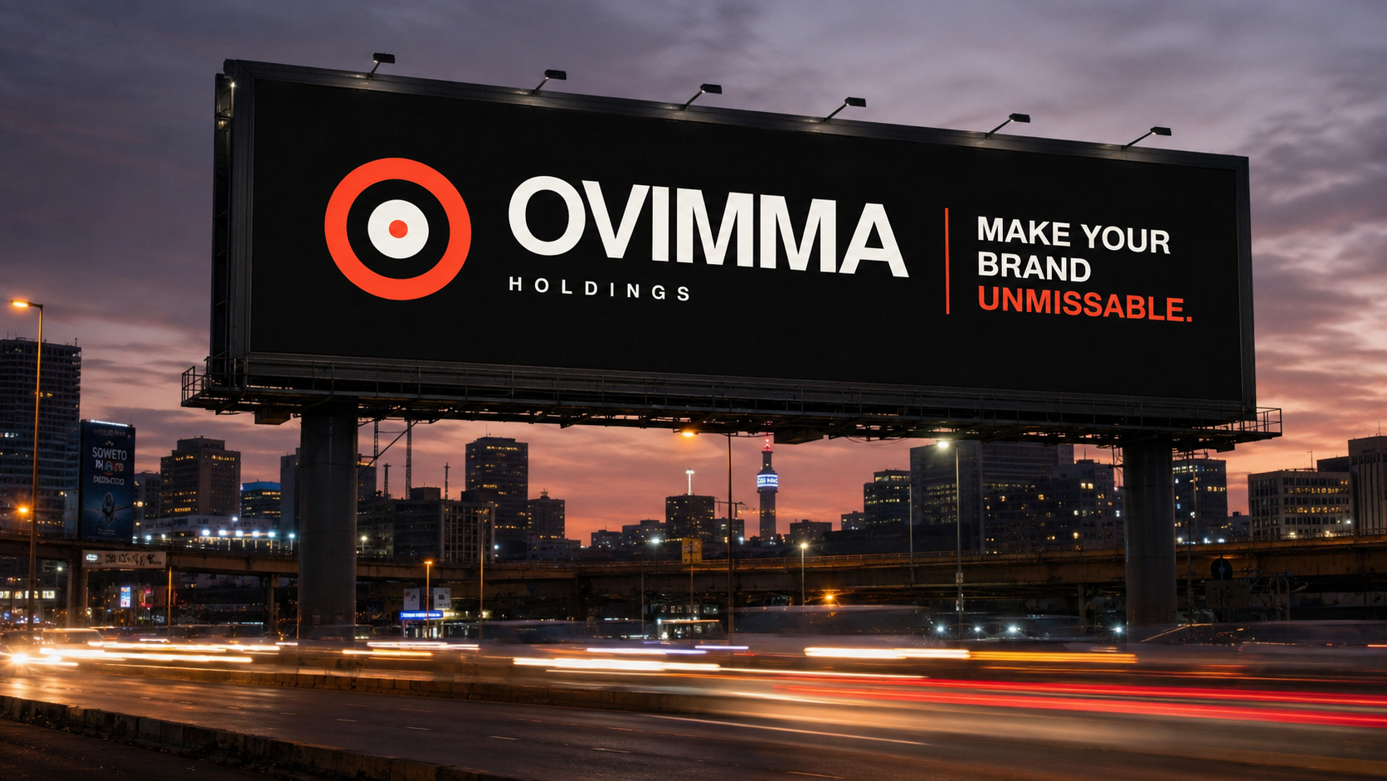

COMPANY CAPABILITIES / 2026
MAKE YOUR BRAND
UNMISSABLE.
Integrated media for ambitious brands.
OUTDOOR • DIGITAL • INFLUENCE • ACTIVATION
OVIMMA HOLDINGS / MEDIA WITHOUT LIMITS.
01

Slide 2
THE PROPOSITION
Media is fragmented.
Your brand shouldn't be.
Ovimma brings strategy, media buying, creator influence and execution into one accountable operation.
ONE PARTNER
EVERY PLATFORM
MAXIMUM IMPACT
OVIMMA HOLDINGS / MEDIA WITHOUT LIMITS.
02

Slide 3
WHAT WE DO
EVERYWHERE
ATTENTION LIVES.
01
OUT-OF-HOME
Billboards, transit, digital OOH and high-impact placements.
↗
02
DIGITAL MEDIA
Search, social, display, programmatic and performance campaigns.
↗
03
INFLUENCE
Creator strategy, talent matching, content and amplification.
↗
04
BRAND EXPERIENCE
Activations, launches, sponsorships and special builds.
↗
OVIMMA HOLDINGS / MEDIA WITHOUT LIMITS.
03

Slide 4
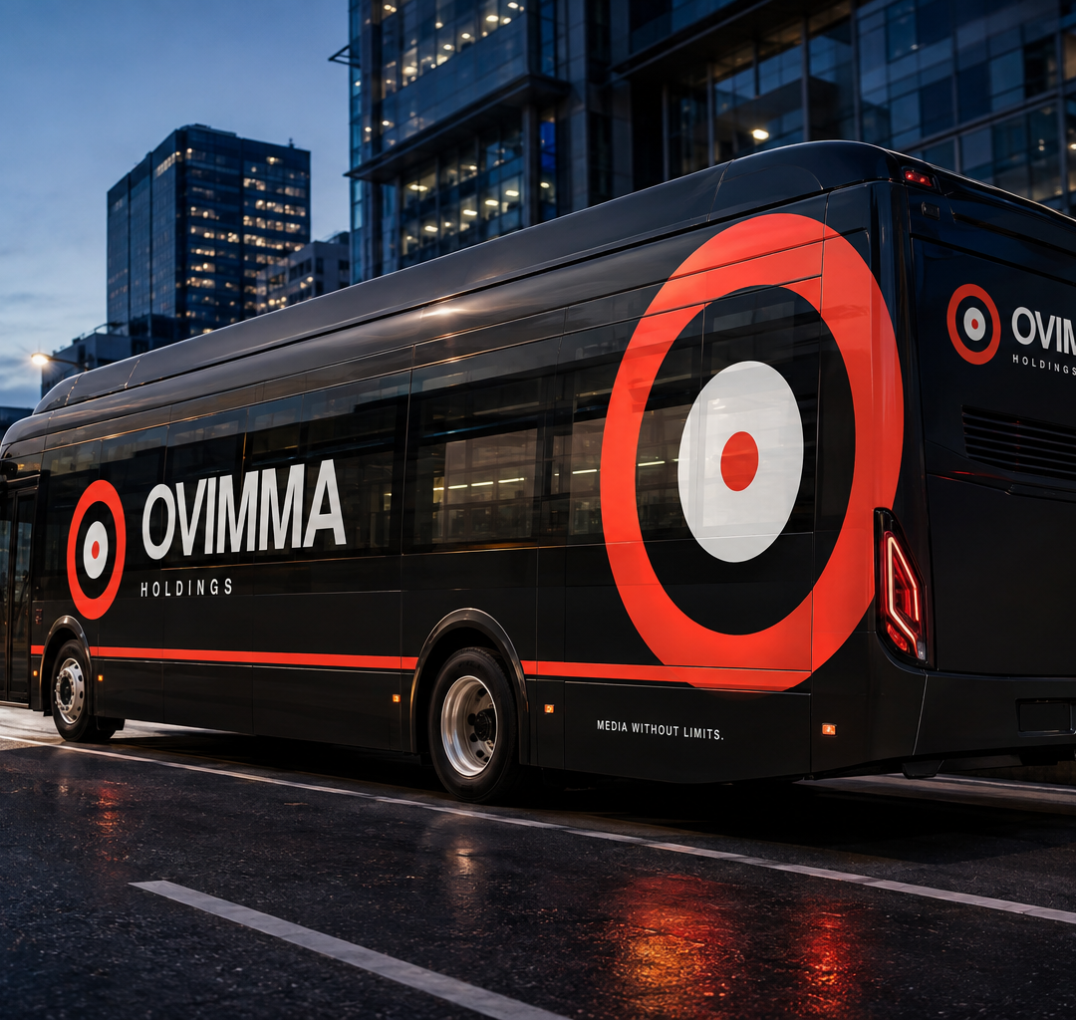
OUTDOOR MEDIA
Own the street.
From a single high-value site to a national out-of-home network, we plan placements around audience movement, context and commercial intent.
BILLBOARDS
Static and digital
TRANSIT
Buses, taxis and routes
SPECIAL BUILDS
High-impact brand moments
OVIMMA HOLDINGS / MEDIA WITHOUT LIMITS.
04

Slide 5
DIGITAL MEDIA
Turn attention
into action.
SEARCH
SOCIAL
Capture existing demand.
Create and convert interest.
Channel strategy, campaigns and optimisation built around the business result—not vanity metrics.
DISPLAY
PERFORMANCE
Build scaled visibility.
Learn, optimise and grow.
OVIMMA HOLDINGS / MEDIA WITHOUT LIMITS.
05

Slide 6
INFLUENCE
REAL VOICES.
REAL CULTURE.
REAL DEMAND.
01
MATCH
02
DIRECT
We match brands with creators by audience, credibility and creative fit—then manage the detail from brief to reporting.
03
AMPLIFY
04
REPORT
OVIMMA HOLDINGS / MEDIA WITHOUT LIMITS.
06

Slide 7
WHO WE WORK WITH
Built for different scales.
Held to one standard.
NATIONAL BRANDS
GROWING SMEs
Integrated campaigns, premium placements and accountable coordination.
Focused media that makes limited spend work harder.
MEDIA PARTNERS
INFLUENCER-LED BRANDS
Reliable inventory, campaign delivery and client-ready execution.
Creator-first growth supported by paid and outdoor amplification.
OVIMMA HOLDINGS / MEDIA WITHOUT LIMITS.
07

Slide 8
HOW WE WORK
A clear path from
brief to breakthrough.
01
02
03
04
DISCOVER
DESIGN
DEPLOY
DRIVE
The audience, tension and opportunity.
The idea, channel mix and campaign system.
Every placement, creator and production detail.
Performance, learning and next action.
OVIMMA HOLDINGS / MEDIA WITHOUT LIMITS.
08

Slide 9
ACCOUNTABILITY
Every campaign earns its next decision.
We define success before launch, monitor delivery while live and close with reporting that makes the next move clear.
01
02
03
04
ALIGN
VERIFY
MEASURE
IMPROVE
Objectives, audience and KPIs.
Placements, assets and creator delivery.
Channel performance and outcomes.
Learnings, optimisation and next actions.
OVIMMA HOLDINGS / MEDIA WITHOUT LIMITS.
09

Slide 10
NEXT MOVE
LET’S MAKE
THEM LOOK.
Start with the brief. We will build the media answer.
NEW CAMPAIGNS
MEDIA & CREATOR PARTNERSHIPS
sales@ovimmaholdings.co.za
media@ovimmaholdings.co.za
OVIMMA HOLDINGS / MEDIA WITHOUT LIMITS.
10

